Slide 1
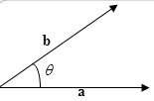
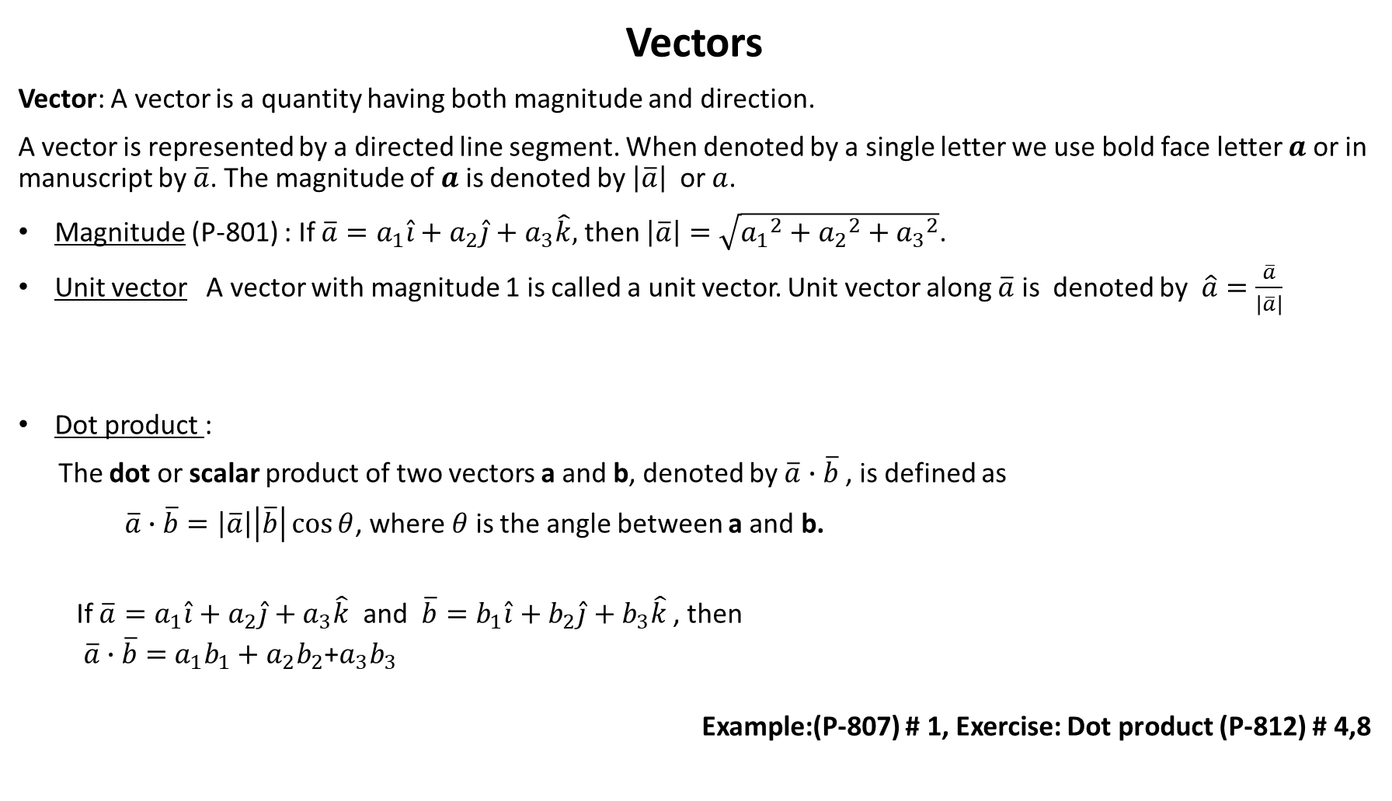
Vectors
Vector: A vector is a quantity having both magnitude and direction.
A vector is represented by a directed line segment. When denoted by a single letter we use bold face letter $a$ or in manuscript by $\overline{a}$. The magnitude of $a$ is denoted by $\left|\overline{a}\right|$ or $a$.
Magnitude (P-801) : If $\overline{a}=a_{1}\hat{i}+a_{2}\hat{j}+a_{3}\hat{k},$ then $\left|\overline{a}\right|=\sqrt{{a_{1}}^{2}+{a_{2}}^{2}+{a_{3}}^{2}}$.
Unit vector A vector with magnitude 1 is called a unit vector. Unit vector along $\overline{a}$ is denoted by $\hat{a}=\frac{\overline{a}}{\left|\overline{a}\right|}$
Dot product :
The dot or scalar product of two vectors a and b, denoted by $\overline{a}∙\overline{b}$ , is defined as
$\overline{a}∙\overline{b}=\left|\overline{a}\right|\left|\overline{b}\right|\cos{θ}$, where $θ$ is the angle between a and b.
If $\overline{a}=a_{1}\hat{i}+a_{2}\hat{j}+a_{3}\hat{k}$ and $\overline{b}=b_{1}\hat{i}+b_{2}\hat{j}+b_{3}\hat{k}$ , then
$\overline{a}∙\overline{b}=$ $a_{1}b_{1}+a_{2}b_{2}$+$a_{3}b_{3}$
Example:(P-807) # 1, Exercise: Dot product (P-812) # 4,8

Slide 2

Examples
If $\overline{a}=2\hat{i}−\hat{j}+3\hat{k},$ then $\left|\overline{a}\right|=\sqrt{2^{2}+{\left(−1\right)}^{2}+3^{2}}=\sqrt{14}$ .
Unit vector along $\overline{a}$ is $\hat{a}=\frac{\overline{a}}{\left|\overline{a}\right|}=\frac{1}{\sqrt{14}}\left(2\hat{i}−\hat{j}+3\hat{k}\right)$.
If $\overline{a}=2\hat{i}−\hat{j}+3\hat{k} and \overline{b}=\hat{i}−2\hat{j}+\hat{k},$
then $\overline{a}∙\overline{b}=$ $a_{1}b_{1}+a_{2}b_{2}$+$a_{3}b_{3}=2.1+\left(−1\right)\left(−2\right)+3.1=7.$

Slide 3
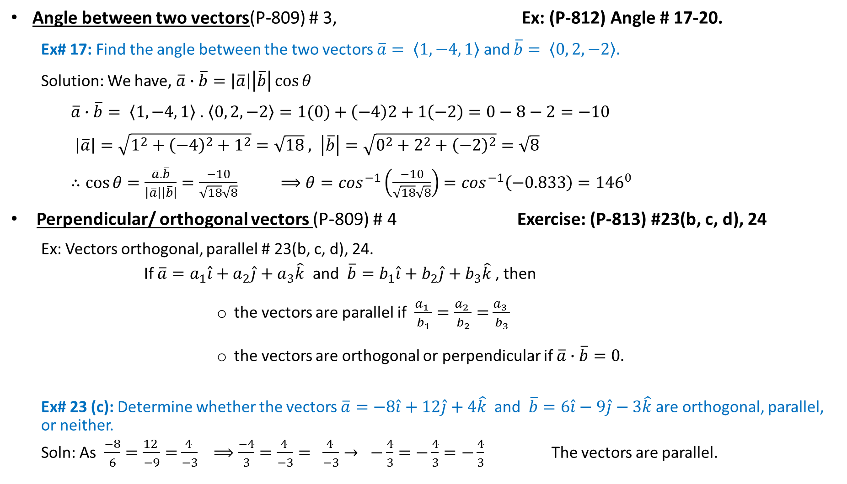
Angle between two vectors(P-809) # 3, Ex: (P-812) Angle # 17-20.
Ex# 17: Find the angle between the two vectors $\overline{a}= \left\langle 1,−4, 1\right\rangle$ and $\overline{b}= \left\langle 0, 2, −2\right\rangle .$
Solution: We have, $\overline{a}∙\overline{b}=\left|\overline{a}\right|\left|\overline{b}\right|\cos{θ}$
$\overline{a}∙\overline{b}= \left\langle 1,−4, 1\right\rangle$ . $\left\langle 0, 2, −2\right\rangle =1(0)+\left(−4\right)2+1\left(−2\right)=0−8−2=−10$
$\left|\overline{a}\right|=\sqrt{1^{2}+{\left(−4\right)}^{2}+1^{2}}=\sqrt{18} , \left|\overline{b}\right|=\sqrt{0^{2}+2^{2}+{\left(−2\right)}^{2}}=\sqrt{8}$
$∴cos{θ}=\frac{\overline{a}.\overline{b}}{\left|\overline{a}\right|\left|\overline{b}\right|}=\frac{−10}{\sqrt{18}\sqrt{8}}$ $⟹θ=\cos^{−1}\left(\frac{−10}{\sqrt{18}\sqrt{8}}\right)=\cos^{−1}\left(−0.833\right)={146}^{0}$
Perpendicular/ orthogonal vectors (P-809) # 4 Exercise: (P-813) #23(b, c, d), 24
Ex: Vectors orthogonal, parallel # 23(b, c, d), 24.
If $\overline{a}=a_{1}\hat{i}+a_{2}\hat{j}+a_{3}\hat{k}$ and $\overline{b}=b_{1}\hat{i}+b_{2}\hat{j}+b_{3}\hat{k}$ , then
the vectors are parallel if $\frac{a_{1} }{b_{1}}=\frac{a_{2} }{b_{2}}=$ $\frac{a_{3} }{b_{3}}$
the vectors are orthogonal or perpendicular if $\overline{a}∙\overline{b}=0.$
Ex# 23 (c): Determine whether the vectors $\overline{a}=−8\hat{i}+12\hat{j}+4\hat{k}$ and $\overline{b}=6\hat{i}−9\hat{j}−3\hat{k}$ are orthogonal, parallel, or neither.
Soln: As $\frac{−8}{6}=\frac{12 }{−9}=$ $\frac{4 }{−3}$ $⟹\frac{−4}{3}=\frac{4 }{−3}= \frac{4 }{−3}→ −\frac{4}{3}=−\frac{4}{3}=−\frac{4}{3}$ The vectors are parallel.

Slide 4
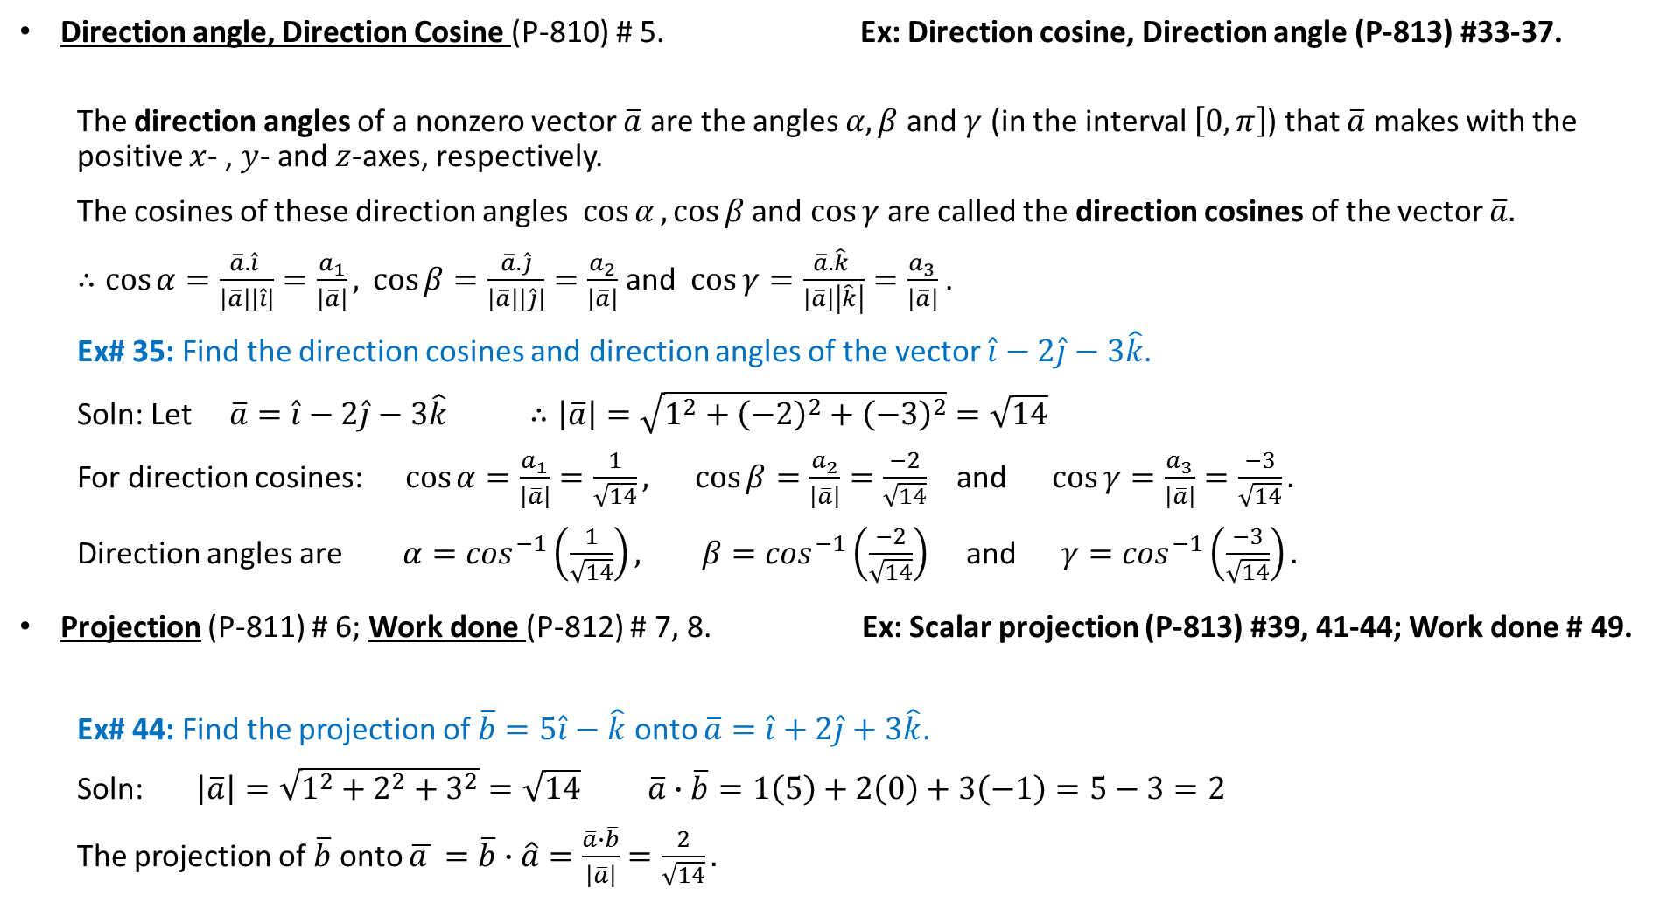
Direction angle, Direction Cosine (P-810) # 5. Ex: Direction cosine, Direction angle (P-813) #33-37.
The direction angles of a nonzero vector $\overline{a}$ are the angles $α, β$and $γ$ (in the interval $\left[0,π\right]$) that $\overline{a}$ makes with the positive $x$- , $y$- and $z$-axes, respectively.
The cosines of these direction angles $\cos{α},\cos{β}$ and $\cos{γ}$are called the direction cosines of the vector $\overline{a}.$
$∴cos{α}=\frac{\overline{a}.\hat{i} }{\left|\overline{a}\right|\left|\hat{i}\right|}=\frac{a_{1}}{\left|\overline{a}\right|}, \cos{β}=\frac{\overline{a}.\hat{j}}{\left|\overline{a}\right|\left|\hat{j}\right|}=\frac{a_{2}}{\left|\overline{a}\right|}$and $\cos{γ}=\frac{\overline{a}.\hat{k} }{\left|\overline{a}\right|\left|\hat{k}\right|}=\frac{a_{3}}{\left|\overline{a}\right|}$.
Ex# 35: Find the direction cosines and direction angles of the vector $\hat{i}−2\hat{j}−3\hat{k}$.
Soln: Let $\overline{a}=\hat{i}−2\hat{j}−3\hat{k}$ $∴\left|\overline{a}\right|=\sqrt{1^{2}+{\left(−2\right)}^{2}+{\left(−3\right)}^{2}}=\sqrt{14}$
For direction cosines: $\cos{α}=\frac{a_{1}}{\left|\overline{a}\right|}=\frac{1}{\sqrt{14}}, \cos{β}=\frac{a_{2}}{\left|\overline{a}\right|}=\frac{−2}{\sqrt{14}}$ and $\cos{γ}=\frac{a_{3}}{\left|\overline{a}\right|}=\frac{−3}{\sqrt{14}}.$
Direction angles are $α=\cos^{−1}\left(\frac{1}{\sqrt{14}}\right), β=\cos^{−1}\left(\frac{−2}{\sqrt{14}}\right)$ and $γ=\cos^{−1}\left(\frac{−3}{\sqrt{14}}\right).$
Projection (P-811) # 6; Work done (P-812) # 7, 8. Ex: Scalar projection (P-813) #39, 41-44; Work done # 49.
Ex# 44: Find the projection of $\overline{b}=5\hat{i}−\hat{k}$ onto $\overline{a}=\hat{i}+2\hat{j}+3\hat{k}$.
Soln: $\left|\overline{a}\right|=\sqrt{1^{2}+2^{2}+3^{2}}=\sqrt{14}$ $\overline{a}∙\overline{b}=1\left(5\right)+2\left(0\right)+3\left(−1\right)=5−3=2$
The projection of $\overline{b}$ onto $\overline{a }=\overline{b}∙\hat{a}=\frac{\overline{a}∙\overline{b}}{\left|\overline{a}\right|}$ $=\frac{2}{\sqrt{14}}.$

Slide 5
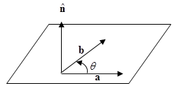
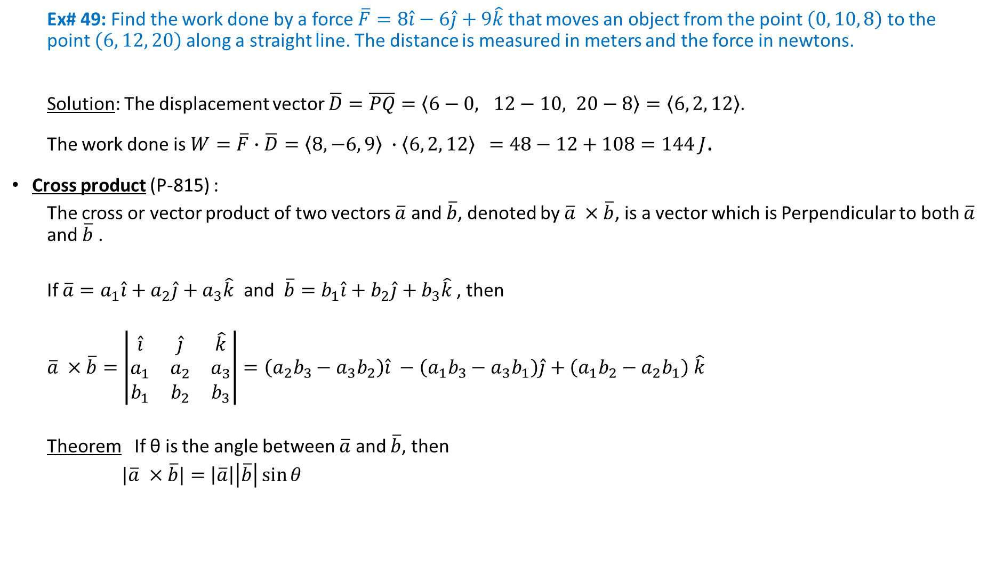
Ex# 49: Find the work done by a force $\overline{F}=8\hat{i}−6\hat{j}+9\hat{k}$ that moves an object from the point $\left(0, 10, 8\right)$to the point $\left(6, 12, 20\right)$along a straight line. The distance is measured in meters and the force in newtons.
Solution: The displacement vector $\overline{D}=\overline{PQ}=\left\langle 6−0, 12−10, 20−8\right\rangle =\left\langle 6, 2, 12\right\rangle$.
The work done is $W=\overline{F}∙\overline{D}=\left\langle 8,−6, 9\right\rangle ∙\left\langle 6, 2, 12\right\rangle$ $=48−12+108=144$ $J$.
Cross product (P-815) :
The cross or vector product of two vectors $\overline{a}$ and $\overline{b}$, denoted by $\overline{a} ×\overline{b}$, is a vector which is Perpendicular to both $\overline{a}$ and $\overline{b}$ .
If $\overline{a}=a_{1}\hat{i}+a_{2}\hat{j}+a_{3}\hat{k}$ and $\overline{b}=b_{1}\hat{i}+b_{2}\hat{j}+b_{3}\hat{k}$ , then
$\overline{a} ×\overline{b}=\left|\begin{matrix}\hat{i} & \hat{j} & \hat{k} \\ a_{1} & a_{2} & a_{3} \\ b_{1} & b_{2} & b_{3}\end{matrix}\right|=\left(a_{2}b_{3}−a_{3}b_{2}\right)\hat{i} −\left(a_{1}b_{3}−a_{3}b_{1}\right)\hat{j}+\left(a_{1}b_{2}−a_{2}b_{1}\right)$ $\hat{k}$
Theorem If θ is the angle between $\overline{a}$ and $\overline{b}$, then
$|\overline{a} ×\overline{b}|=$ $\left|\overline{a}\right|\left|\overline{b}\right|\sin{θ}$

Slide 6
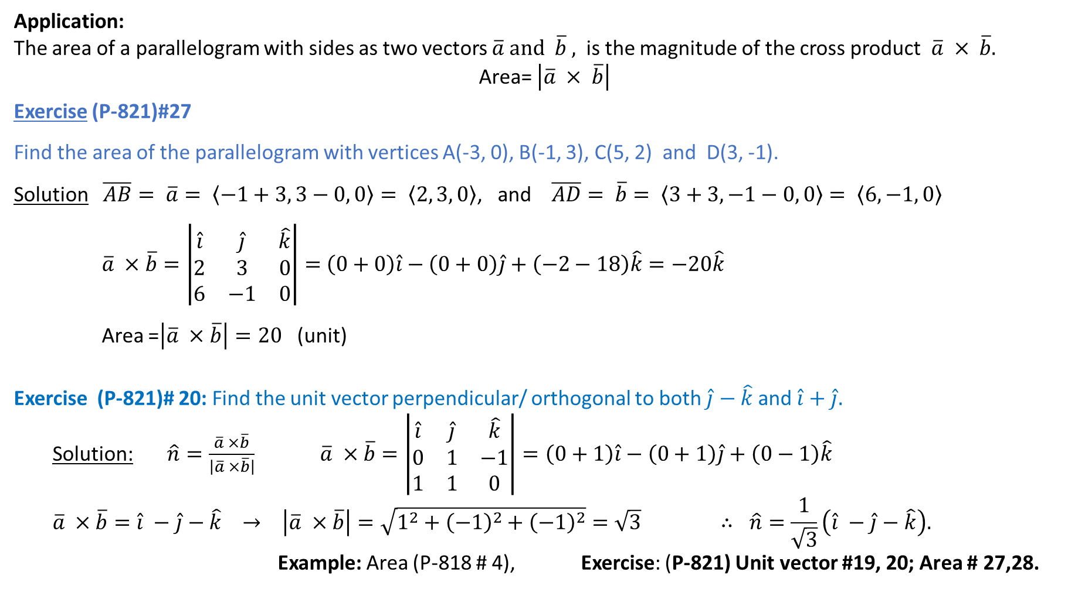
Application:
The area of a parallelogram with sides as two vectors $\overline{a} and \overline{b} ,$ is the magnitude of the cross product $\overline{a} × \overline{b}.$
Area= $\left|\overline{a} × \overline{b}\right|$
Exercise (P-821)#27
Find the area of the parallelogram with vertices A(-3, 0), B(-1, 3), C(5, 2) and D(3, -1).
Solution $\overline{AB}= \overline{a}= \left\langle −1+3, 3−0, \left.0\right\rangle \right.= \left\langle 2, 3, \left.0\right\rangle \right.$, and $\overline{AD}= \overline{b}= \left\langle 3+3, −1−0, \left.0\right\rangle = \left\langle 6, −1, \left.0\right\rangle \right. \right.$
$\overline{a} ×\overline{b}=\left|\begin{matrix}\hat{i} & \hat{j} & \hat{k} \\ 2 & 3 & 0 \\ 6 & −1 & 0\end{matrix}\right|=$ $\left(0+0\right)\hat{i}−\left(0+0\right)\hat{j}+\left(−2−18\right)\hat{k}=−20\hat{k}$
Area =$\left|\overline{a} ×\overline{b}\right|=20$ (unit)
Exercise (P-821)# 20: Find the unit vector perpendicular/ orthogonal to both $\hat{j}−\hat{k}$ and $\hat{i}+\hat{j}.$
Solution: $\hat{n}=\frac{\overline{a} ×\overline{b}}{\left|\overline{a} ×\overline{b}\right|}$ $\overline{a} ×\overline{b}=\left|\begin{matrix}\hat{i} & \hat{j} & \hat{k} \\ 0 & 1 & −1 \\ 1 & 1 & 0\end{matrix}\right|=\left(0+1\right)\hat{i}−\left(0+1\right)\hat{j}+\left(0−1\right)\hat{k}$
$$\overline{a} ×\overline{b}=\hat{i} −\hat{j}−\hat{k} → \left|\overline{a} ×\overline{b}\right|=\sqrt{1^{2}+{\left(−1\right)}^{2}+{\left(−1\right)}^{2}}=\sqrt{3} ∴ \hat{n}=\frac{1}{\sqrt{3}}\left(\hat{i} −\hat{j}−\hat{k}\right).$$
Example: Area (P-818 # 4), Exercise: (P-821) Unit vector #19, 20; Area # 27,28.
B(-1, 3)
C(5, 2)
A(-3.0)
D(3, -1)

Slide 7
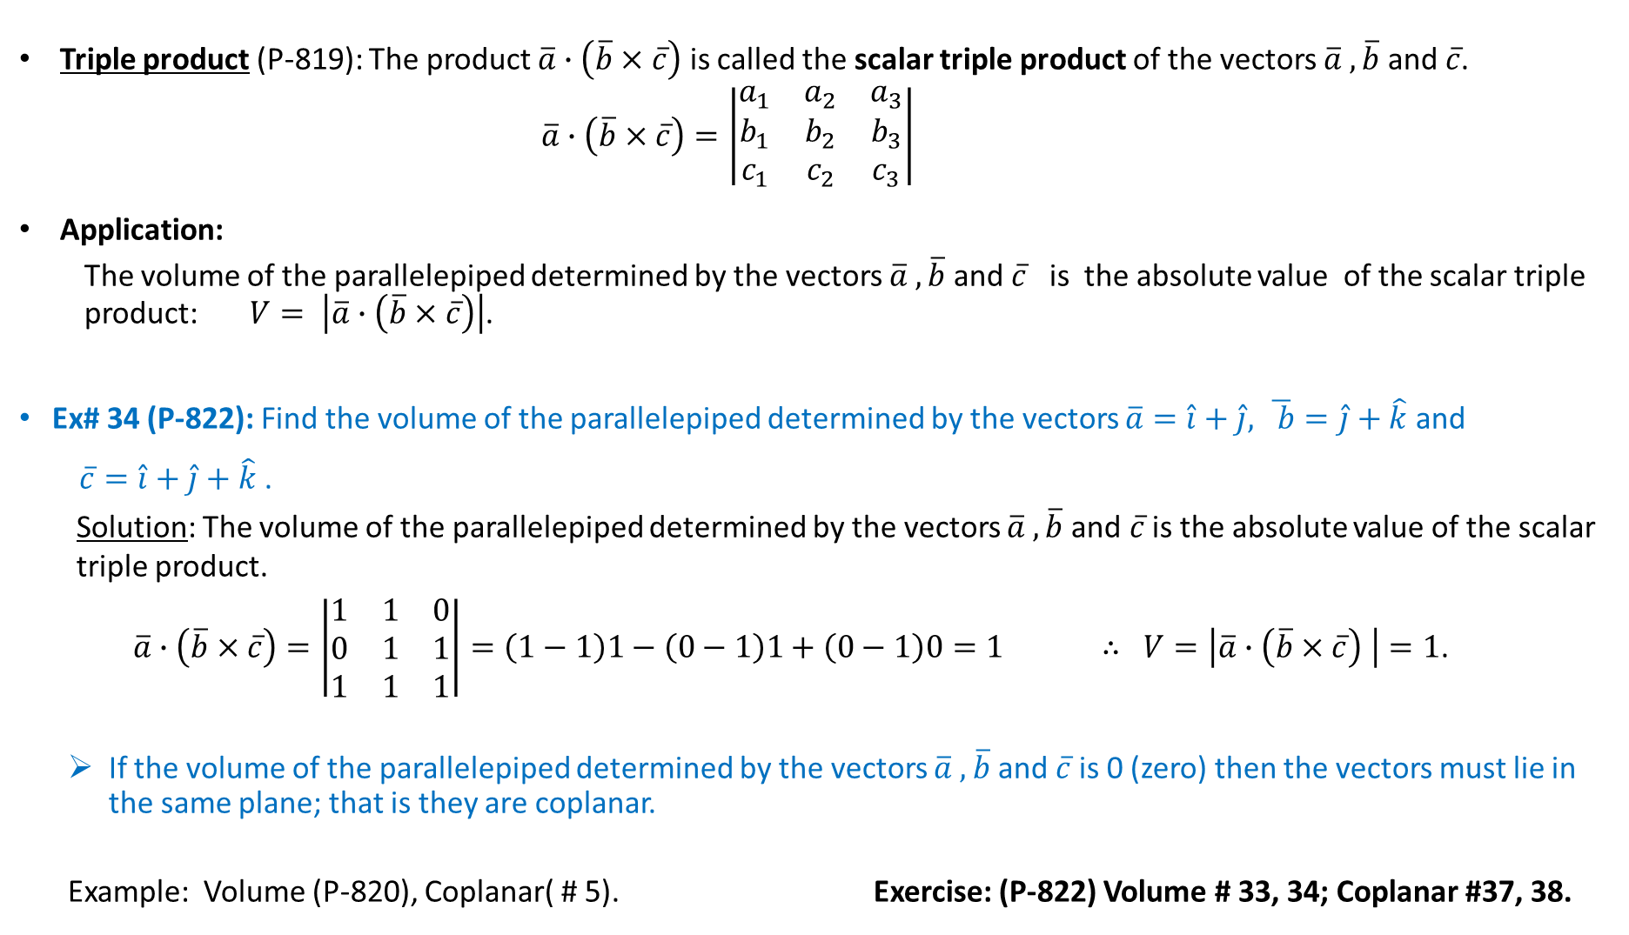
Triple product (P-819): The product $\overline{a}∙\left(\overline{b}×\overline{c}\right)$ is called the scalar triple product of the vectors $\overline{a} ,\overline{b}$and $\overline{c}$.
$$\overline{a}∙\left(\overline{b}×\overline{c}\right)=\left|\begin{matrix}a_{1} & a_{2} & a_{3} \\ b_{1} & b_{2} & b_{3} \\ c_{1} & c_{2} & c_{3}\end{matrix}\right|$$
Application:
The volume of the parallelepiped determined by the vectors $\overline{a} ,\overline{b}$and $\overline{c}$ is the absolute value of the scalar triple product: $V= \left|\overline{a}∙\left(\overline{b}×\overline{c}\right)\right|$.
Ex# 34 (P-822): Find the volume of the parallelepiped determined by the vectors $\overline{a}=\hat{i}+\hat{j},$ $\overline{ b}=\hat{j}+\hat{k}$ and
$\overline{c}=\hat{i}+\hat{j}+\hat{k}$ .
Solution: The volume of the parallelepiped determined by the vectors $\overline{a} ,\overline{b}$and $\overline{c}$ is the absolute value of the scalar triple product.
$\overline{a}∙\left(\overline{b}×\overline{c}\right)=\left|\begin{matrix}1 & 1 & 0 \\ 0 & 1 & 1 \\ 1 & 1 & 1\end{matrix}\right|=\left(1−1\right)1−\left(0−1\right)1+\left(0−1\right)0=1$ $∴ V=\left|\overline{a}∙\left(\overline{b}×\overline{c}\right) \right|=1$.
If the volume of the parallelepiped determined by the vectors $\overline{a} ,\overline{b}$and $\overline{c}$ is 0 (zero) then the vectors must lie in the same plane; that is they are coplanar.
Example: Volume (P-820), Coplanar( # 5). Exercise: (P-822) Volume # 33, 34; Coplanar #37, 38.

Slide 8
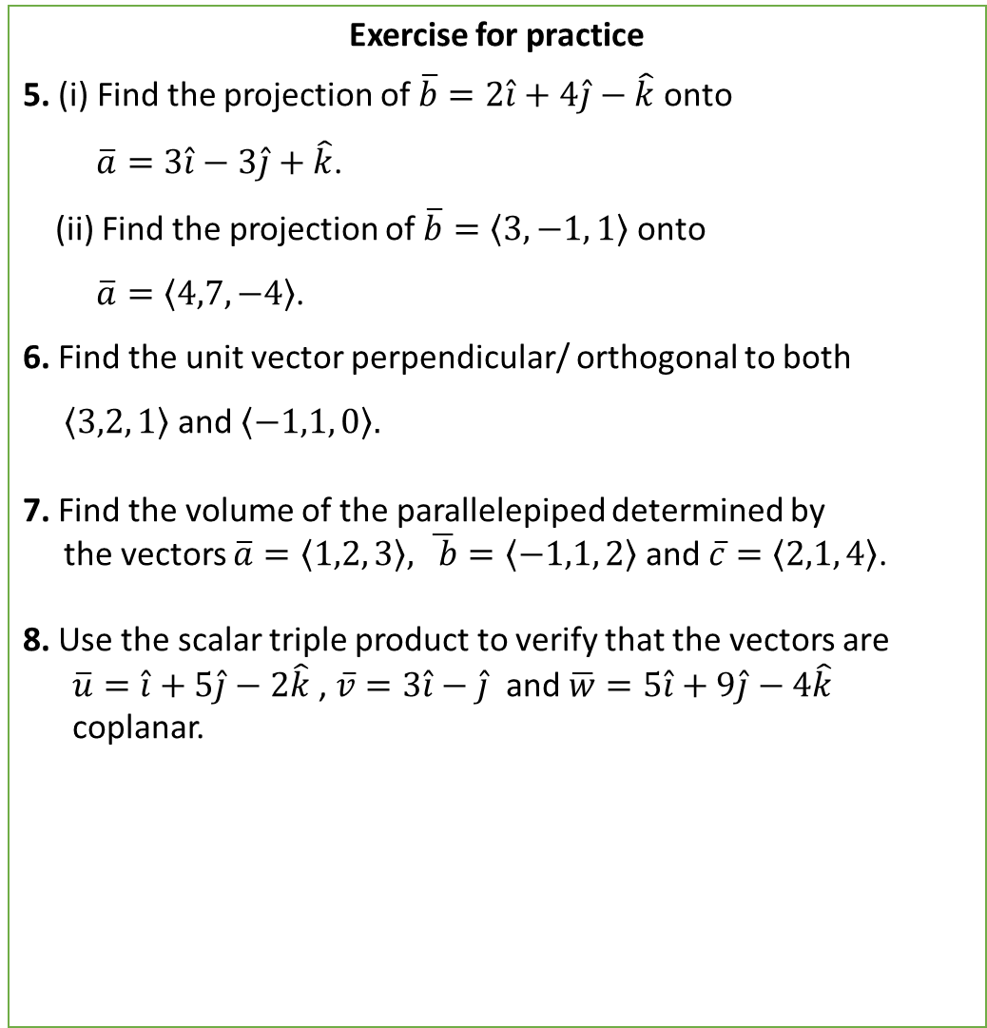
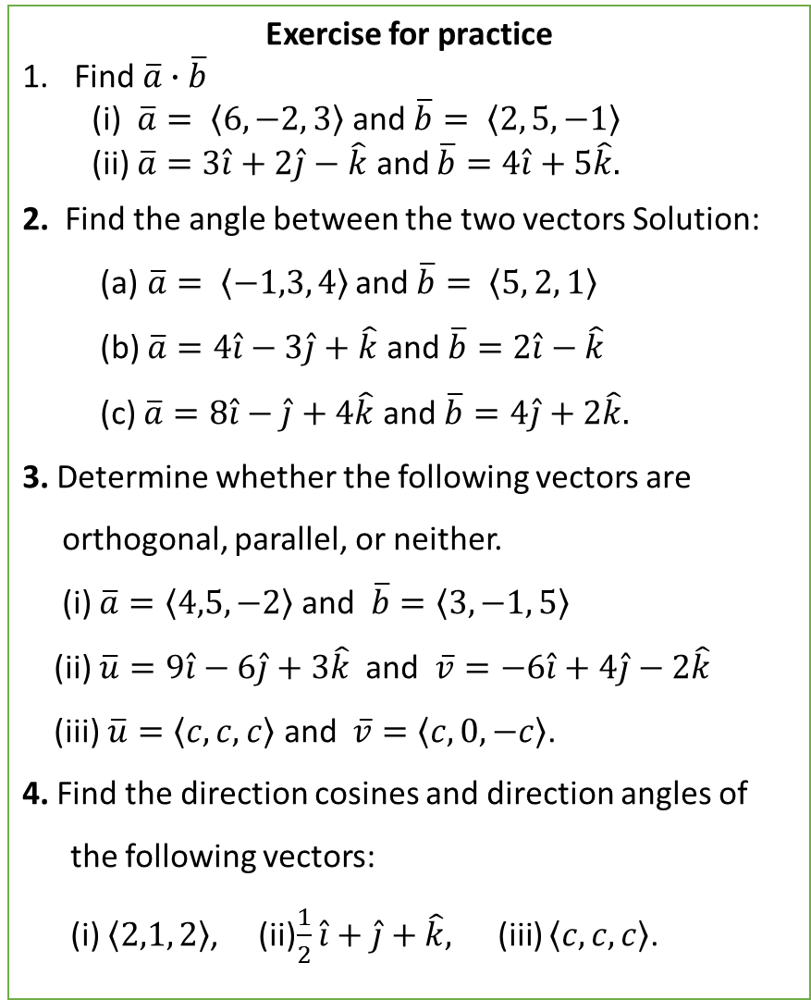
Exercise for practice
Find $\overline{a}∙\overline{b}$
(i) $\overline{a}= \left\langle 6,−2, 3\right\rangle$ and $\overline{b}= \left\langle 2, 5, −1\right\rangle$
(ii) $\overline{a}=3\hat{i}+2\hat{j}−\hat{k}$ and $\overline{b}=4\hat{i}+5\hat{k}.$
2. Find the angle between the two vectors Solution:
(a)$\overline{a}= \left\langle −1,3, 4\right\rangle$ and $\overline{b}= \left\langle 5, 2, 1\right\rangle$
(b) $\overline{a}=4\hat{i}−3\hat{j}+\hat{k}$ and $\overline{b}=2\hat{i}−\hat{k}$
(c) $\overline{a}=8\hat{i}−\hat{j}+4\hat{k}$ and $\overline{b}=4\hat{j}+2\hat{k}.$
3. Determine whether the following vectors are
orthogonal, parallel, or neither.
(i) $\overline{a}=\left\langle 4,5, −2\right\rangle$ and $\overline{b}=\left\langle 3, −1, 5\right\rangle$
(ii) $\overline{u}=9\hat{i}−6\hat{j}+3\hat{k}$ and $\overline{v}=−6\hat{i}+4\hat{j}−2\hat{k}$
(iii) $\overline{u}=\left\langle c,c,c\right\rangle$ and $\overline{v}=\left\langle c, 0, −c\right\rangle$.
4. Find the direction cosines and direction angles of
the following vectors:
(i) $\left\langle 2,1, 2\right\rangle$, (ii)$\frac{1}{2}\hat{i}+\hat{j}+\hat{k},$(iii) $\left\langle c,c,c\right\rangle$.
Exercise for practice
5. (i) Find the projection of $\overline{b}=2\hat{i}+4\hat{j}−\hat{k}$ onto
$\overline{a}=3\hat{i}−3\hat{j}+\hat{k}$.
(ii) Find the projection of $\overline{b}=\left\langle 3,−1, 1\right\rangle$ onto
$\overline{a}=\left\langle 4,7, −4\right\rangle$.
6. Find the unit vector perpendicular/ orthogonal to both
$\left\langle 3,2, 1\right\rangle$and $\left\langle −1,1, 0\right\rangle .$
7. Find the volume of the parallelepiped determined by
the vectors $\overline{a}=\left\langle 1,2, 3\right\rangle ,$ $\overline{ b}=\left\langle −1,1, 2\right\rangle$ and $\overline{c}=\left\langle 2,1, 4\right\rangle$.
8. Use the scalar triple product to verify that the vectors are
$\overline{u}=\hat{i}+5\hat{j}−2\hat{k}$ , $\overline{v}=3\hat{i}−\hat{j}$ and $\overline{w}=5\hat{i}+9\hat{j}−4\hat{k}$
coplanar.

Slide 9
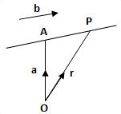
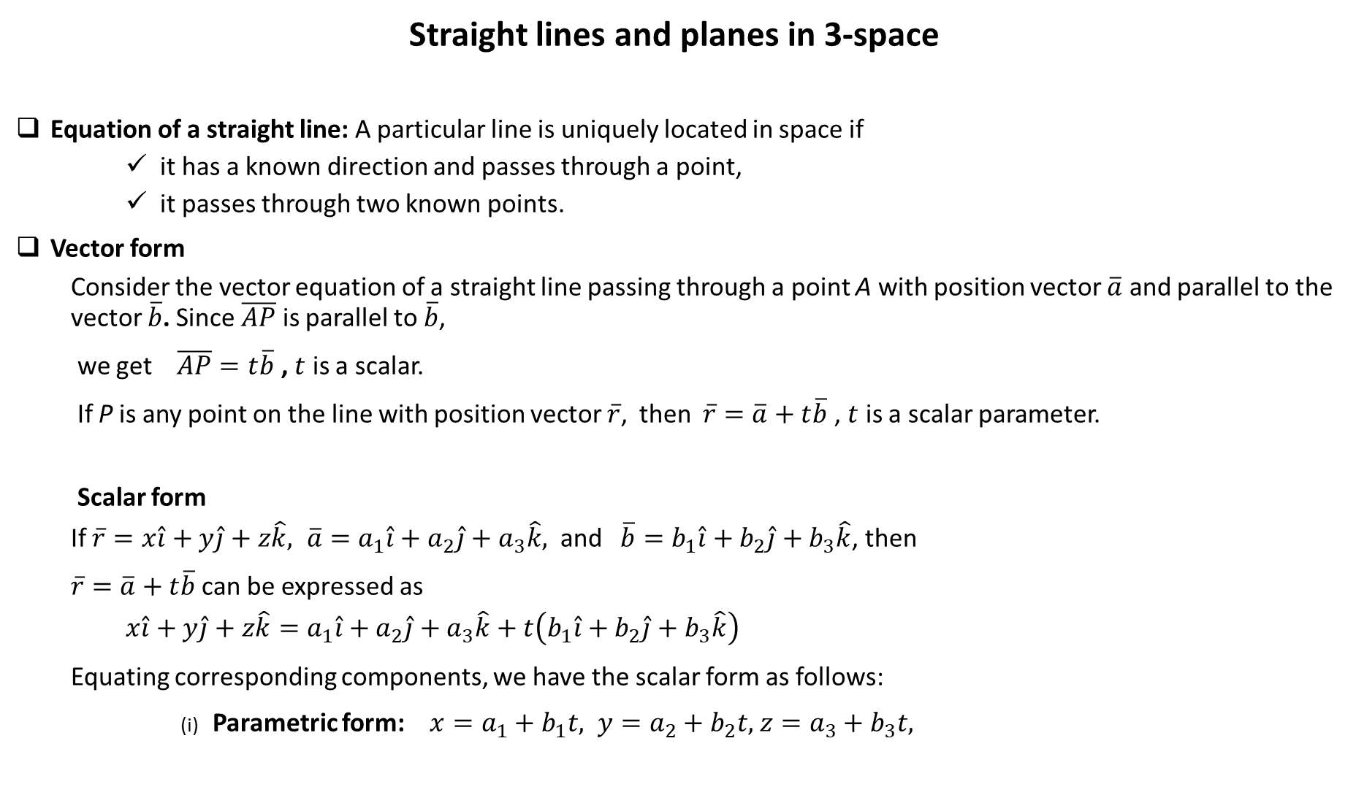
Straight lines and planes in 3-space
Equation of a straight line: A particular line is uniquely located in space if
it has a known direction and passes through a point,
it passes through two known points.
Vector form
Consider the vector equation of a straight line passing through a point A with position vector $\overline{a}$ and parallel to the vector $\overline{b}$. Since $\overline{AP}$ is parallel to $\overline{b}$,
we get $\overline{AP}=t\overline{b}$ , $t$ is a scalar.
If P is any point on the line with position vector $\overline{r}$, then $\overline{r}=\overline{a}+t\overline{b}$, $t$ is a scalar parameter.
Scalar form
If $\overline{r}=x\hat{i}+y\hat{j}+z\hat{k}, \overline{a}=a_{1}\hat{i}+a_{2}\hat{j}+a_{3}\hat{k},$ and $\overline{b}=b_{1}\hat{i}+b_{2}\hat{j}+b_{3}\hat{k}$, then
$\overline{r}=\overline{a}+t\overline{b}$can be expressed as
$$x\hat{i}+y\hat{j}+z\hat{k}=a_{1}\hat{i}+a_{2}\hat{j}+a_{3}\hat{k}+t\left(b_{1}\hat{i}+b_{2}\hat{j}+b_{3}\hat{k}\right)$$
Equating corresponding components, we have the scalar form as follows:
(i) Parametric form: $x=a_{1}+b_{1}t,$ $y=a_{2}+b_{2}t,$ $z=a_{3}+b_{3}t,$

Slide 10
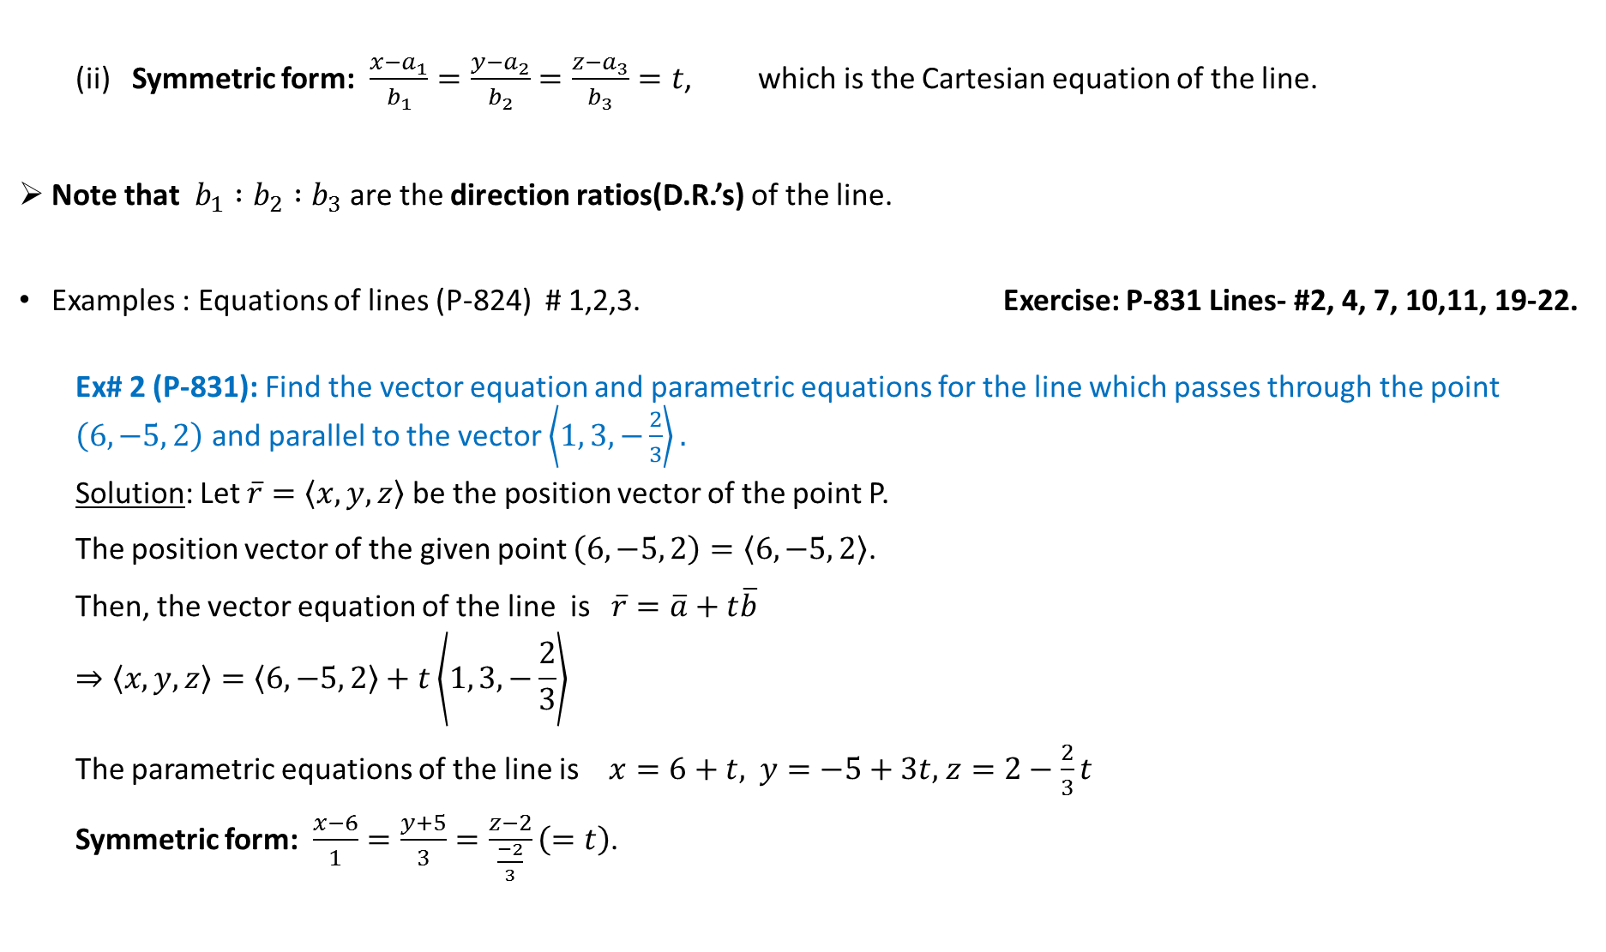
(ii) Symmetric form: $\frac{x−a_{1}}{b_{1}}=\frac{y−a_{2}}{b_{2}}=\frac{z−a_{3}}{b_{3}}=t$, which is the Cartesian equation of the line.
Note that $b_{1}∶b_{2}∶b_{3}$ are the direction ratios(D.R.’s) of the line.
Examples : Equations of lines (P-824) # 1,2,3. Exercise: P-831 Lines- #2, 4, 7, 10,11, 19-22.
Ex# 2 (P-831): Find the vector equation and parametric equations for the line which passes through the point $\left(6, −5, 2\right)$ and parallel to the vector $\left\langle 1, 3, −\frac{2}{3}\right\rangle .$
Solution: Let $\overline{r}=\left\langle x,y,z\right\rangle$be the position vector of the point P.
The position vector of the given point $\left(6, −5, 2\right)=\left\langle 6,−5, 2\right\rangle$.
Then, the vector equation of the line is $\overline{r}=\overline{a}+t\overline{b}$
$$⇒\left\langle x,y,z\right\rangle =\left\langle 6,−5, 2\right\rangle +t\left\langle 1, 3, −\frac{2}{3}\right\rangle$$
The parametric equations of the line is $x=6+t,$ $y=−5+3t,$ $z=2−\frac{2}{3}t$
Symmetric form: $\frac{x−6}{1}=\frac{y+5}{3}=\frac{z−2}{\frac{−2}{3}}\left(=t\right)$.

Slide 11
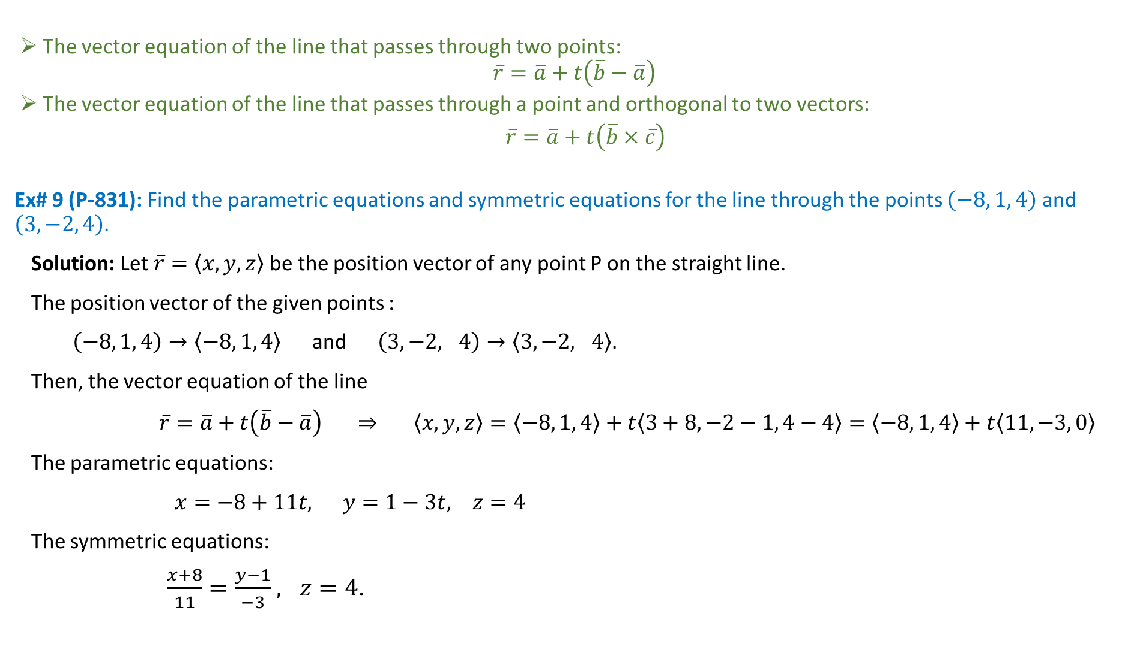
The vector equation of the line that passes through two points:
$$\overline{r}=\overline{a}+t\left(\overline{b}−\overline{a}\right)$$
The vector equation of the line that passes through a point and orthogonal to two vectors:
$\overline{r}=\overline{a}+t\left(\overline{b}×\overline{c}\right)$
Ex# 9 (P-831): Find the parametric equations and symmetric equations for the line through the points $\left(−8, 1, 4\right)$ and $\left(3, −2, 4\right).$
Solution: Let $\overline{r}=\left\langle x,y,z\right\rangle$be the position vector of any point P on the straight line.
The position vector of the given points :
$\left(−8, 1, 4\right)→\left\langle −8, 1, 4\right\rangle$ and $\left(3, −2, 4\right)→\left\langle 3,−2, 4\right\rangle .$
Then, the vector equation of the line
$\overline{r}=\overline{a}+t\left(\overline{b}−\overline{a}\right)$ $⇒ \left\langle x,y,z\right\rangle =\left\langle −8, 1, 4\right\rangle +t\left\langle 3+8, −2−1, 4−4\right\rangle =\left\langle −8, 1, 4\right\rangle +t\left\langle 11, −3, 0\right\rangle$
The parametric equations:
$x=−8+11t,$ $y=1−3t,$ $z=4$
The symmetric equations:
$\frac{x+8}{11}=\frac{y−1}{−3}$ $, z=4$.

Slide 12
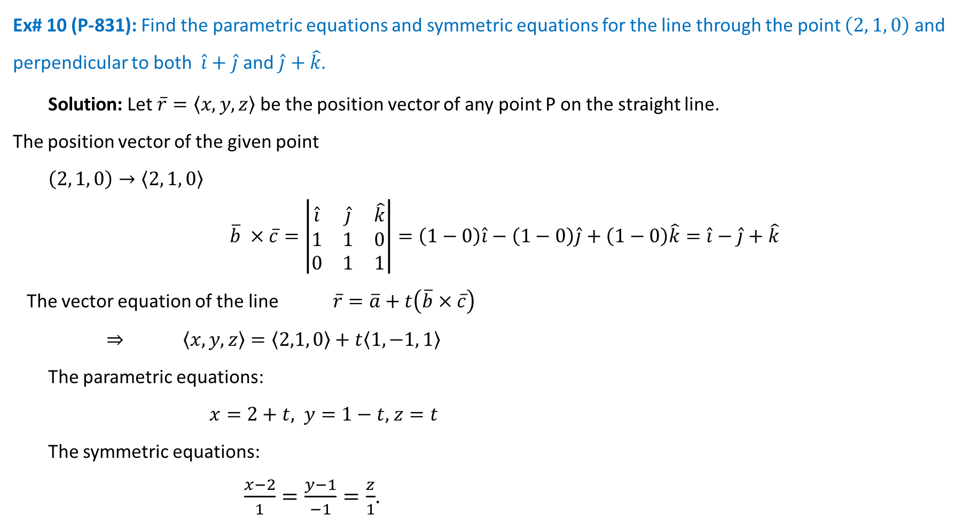
Ex# 10 (P-831): Find the parametric equations and symmetric equations for the line through the point $\left(2, 1, 0\right)$ and perpendicular to both $\hat{i}+\hat{j}$ and $\hat{j}+\hat{k}$.
Solution: Let $\overline{r}=\left\langle x,y,z\right\rangle$be the position vector of any point P on the straight line.
The position vector of the given point
$\left(2, 1, 0\right)→\left\langle 2, 1, 0\right\rangle$
$$\overline{b} ×\overline{c}=\left|\begin{matrix}\hat{i} & \hat{j} & \hat{k} \\ 1 & 1 & 0 \\ 0 & 1 & 1\end{matrix}\right|=\left(1−0\right)\hat{i}−\left(1−0\right)\hat{j}+\left(1−0\right)\hat{k}=\hat{i}−\hat{j}+\hat{k}$$
The vector equation of the line $\overline{r}=\overline{a}+t\left(\overline{b}×\overline{c}\right)$
$⇒ \left\langle x,y,z\right\rangle =\left\langle 2,1, 0\right\rangle +t\left\langle 1, −1, 1\right\rangle$
The parametric equations:
$x=2+t,$ $y=1−t,$ $z=t$
The symmetric equations:
$\frac{x−2}{1}=\frac{y−1}{−1}=\frac{z}{1}$.

Slide 13
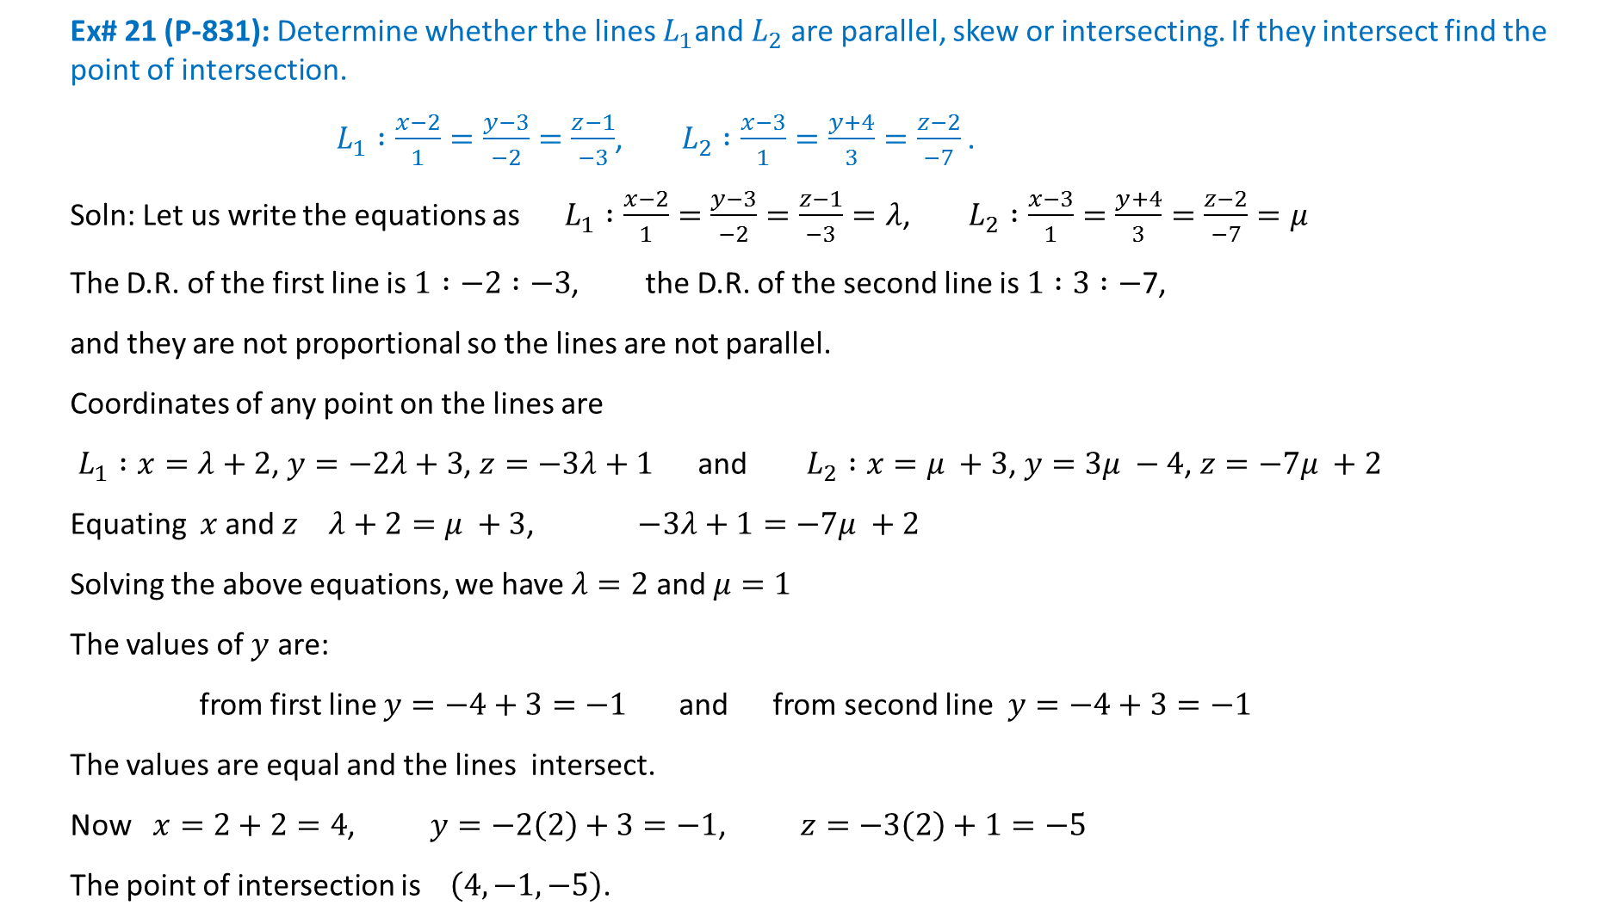
Ex# 21 (P-831): Determine whether the lines $L_{1}$and $L_{2}$are parallel, skew or intersecting. If they intersect find the point of intersection.
$L_{1}∶\frac{x−2}{1}=\frac{y−3}{−2}=\frac{z−1}{−3}$, $L_{2}∶\frac{x−3}{1}=\frac{y+4}{3}=\frac{z−2}{−7}$ .
Soln: Let us write the equations as $L_{1}∶\frac{x−2}{1}=\frac{y−3}{−2}=\frac{z−1}{−3}=λ$, $L_{2}∶\frac{x−3}{1}=\frac{y+4}{3}=\frac{z−2}{−7}=μ$
The D.R. of the first line is $1∶−2∶−3$, the D.R. of the second line is $1∶3∶−$7,
and they are not proportional so the lines are not parallel.
Coordinates of any point on the lines are
$L_{1}∶x=λ+2$, $y=−2λ+3$, $z=−3λ+1$ and $L_{2}∶x=μ +3$, $y=3μ −4$, $z=−7μ +2$
Equating $x$ and $z$ $λ+2=μ +3$, $−3λ+1=−7μ +2$
Solving the above equations, we have $λ=2$ and $μ=1$
The values of $y$ are:
from first line $y=−4+3=−1$ and from second line $y=−4+3=−1$
The values are equal and the lines intersect.
Now $x=2+2=4$, $y=−2\left(2\right)+3=−1$, $z=−3\left(2\right)+1=−5$
The point of intersection is $\left(4, −1, −5\right)$.

Slide 14

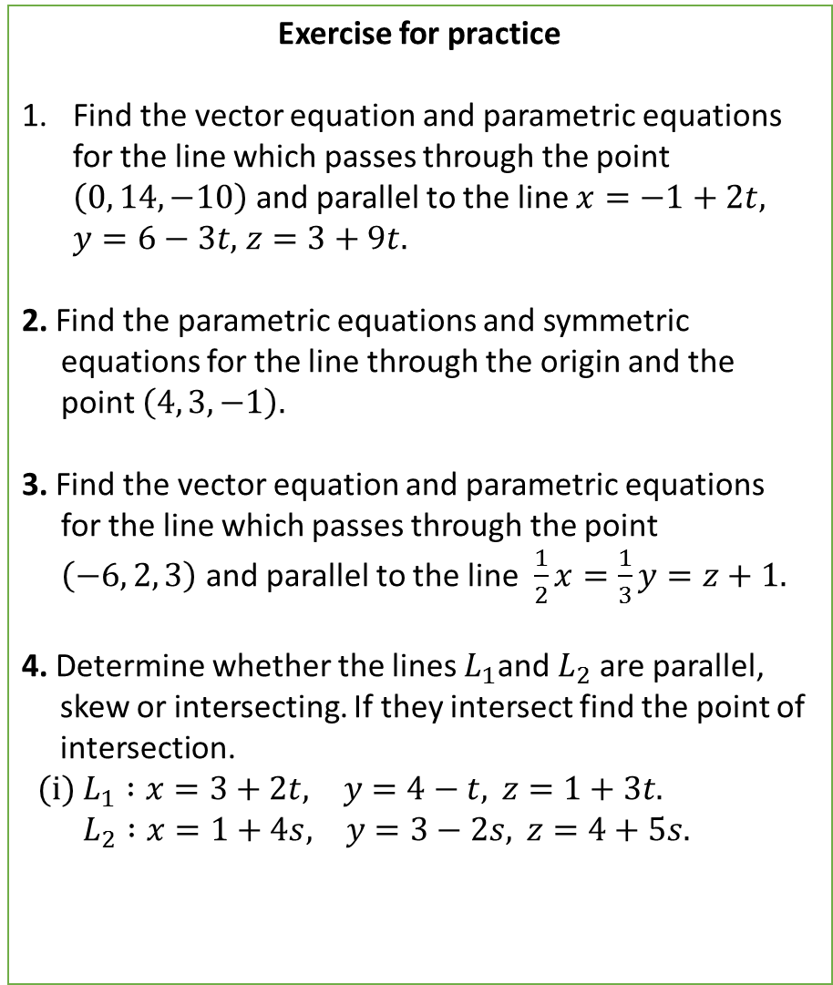
Exercise for practice
Find the vector equation and parametric equations for the line which passes through the point $\left(0, 14, −10\right)$ and parallel to the line $x=−1+2t,$ $y=6−3t,$ $z=3+9t.$
2. Find the parametric equations and symmetric
equations for the line through the origin and the
point $\left(4, 3, −1\right).$
3. Find the vector equation and parametric equations
for the line which passes through the point
$\left(−6, 2, 3\right)$ and parallel to the line $\frac{1}{2}x=\frac{1}{3}y=z+1.$
4. Determine whether the lines $L_{1}$and $L_{2}$are parallel,
skew or intersecting. If they intersect find the point of
intersection.
(i) $L_{1}∶x=3+2t, y=4−t, z=1+3t.$
$L_{2}∶x=1+4s, y=3−2s, z=4+5s.$
Exercise for practice
(ii) $L_{1}∶x=5−12t, y=3+9t, z=1−3t.$
$L_{2}∶x=3+8s, y=−6s, z=7+2s.$
(iii) $L_{1}∶\frac{x}{1}=\frac{y−1}{−1}=\frac{z−2}{3}$, $L_{2}∶\frac{x−2}{2}=\frac{y−3}{−2}=\frac{z}{7}$.

Slide 15
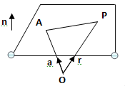
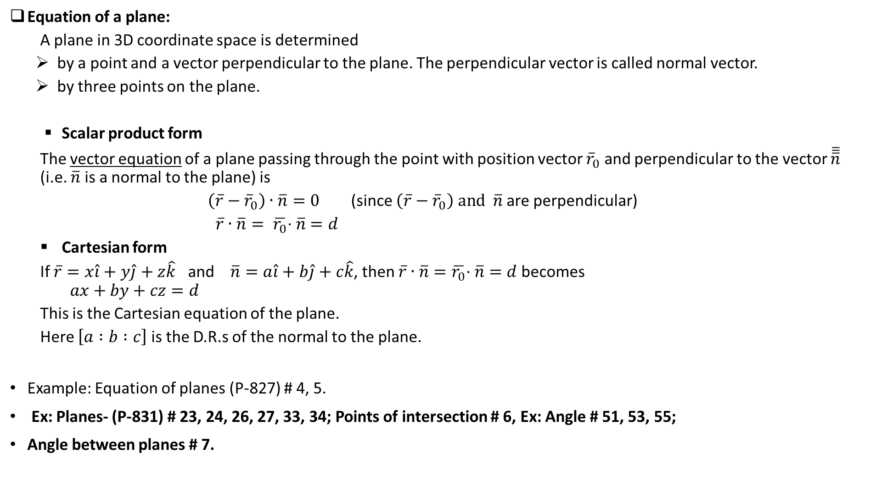
Equation of a plane:
A plane in 3D coordinate space is determined
by a point and a vector perpendicular to the plane. The perpendicular vector is called normal vector.
by three points on the plane.
Scalar product form
The vector equation of a plane passing through the point with position vector ${\overline{r}}_{0}$ and perpendicular to the vector $\overline{\overline{\overline{n}}}$ (i.e. $\overline{n}$ is a normal to the plane) is
$\left(\overline{r}−{\overline{r}}_{0}\right)∙$ $\overline{n}=0$ (since $\left(\overline{r}−{\overline{r}}_{0}\right) and$ $\overline{n}$ are perpendicular)
$\overline{r}∙\overline{n}= \overline{r_{0}}\text{∙} \overline{n}=d$
Cartesian form
If $\overline{r}=x\hat{i}+y\hat{j}+z\hat{k}$ and $\overline{n}=a\hat{i}+b\hat{j}+c\hat{k}$, then $\overline{r}∙\overline{n}=\overline{r_{0}}\text{∙} \overline{n}=d$ becomes
$$ax+by+cz=d$$
This is the Cartesian equation of the plane.
Here $\left[a∶b∶c\right]$is the D.R.s of the normal to the plane.
Example: Equation of planes (P-827) # 4, 5.
Ex: Planes- (P-831) # 23, 24, 26, 27, 33, 34; Points of intersection # 6, Ex: Angle # 51, 53, 55;
Angle between planes # 7.

Slide 16
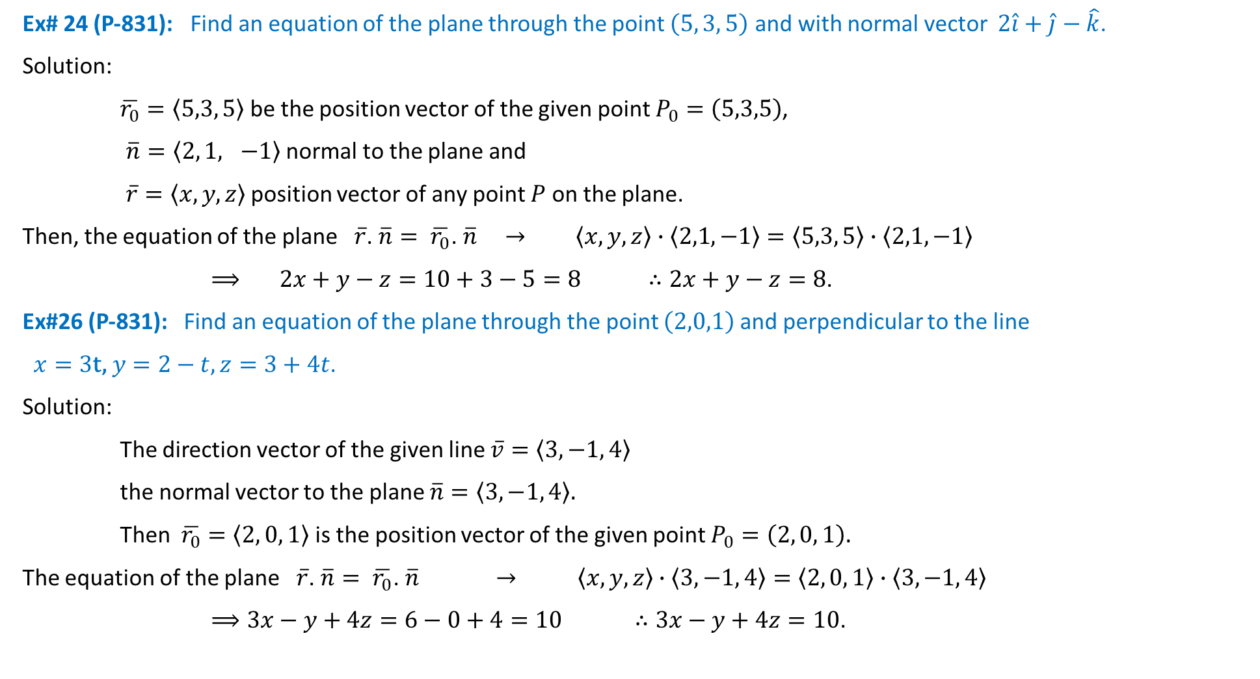
Ex# 24 (P-831): Find an equation of the plane through the point $\left(5, 3, 5\right)$ and with normal vector $2\hat{i}+\hat{j}−\hat{k}$.
Solution:
$\overline{r_{0}}=\left\langle 5,3, 5\right\rangle$ be the position vector of the given point $P_{0}=\left(5,3,5\right)$,
$\overline{n}=\left\langle 2, 1, −1\right\rangle$ normal to the plane and
$\overline{r}=\left\langle x,y, z\right\rangle$ position vector of any point $P$ on the plane.
Then, the equation of the plane $\overline{r}$. $\overline{n}= \overline{r_{0}}\text{. }\overline{n} → \left\langle x,y, z\right\rangle ∙\left\langle 2,1, −1\right\rangle =\left\langle 5,3, 5\right\rangle ∙\left\langle 2,1, −1\right\rangle$
$⟹ 2x+y−z=10+3−5=8$ $∴2x+y−z=8$.
Ex#26 (P-831): Find an equation of the plane through the point $\left(2,0,1\right)$ and perpendicular to the line
$x=3\text{t}\text{,} y=2−t,z=3+4t$.
Solution:
The direction vector of the given line $\overline{v}=\left\langle 3, −1, 4\right\rangle$
the normal vector to the plane $\overline{n}=\left\langle 3, −1, 4\right\rangle .$
Then $\overline{r_{0}}=\left\langle 2, 0, 1\right\rangle$ is the position vector of the given point $P_{0}=\left(2, 0, 1\right).$
The equation of the plane $\overline{r}$. $\overline{n}= \overline{r_{0}}\text{. }\overline{n} → \left\langle x,y, z\right\rangle ∙\left\langle 3, −1, 4\right\rangle =\left\langle 2, 0, 1\right\rangle ∙\left\langle 3, −1, 4\right\rangle$
$⟹3x−y+4z=6−0+4=10$ $∴3x−y+4z=10$.

Slide 17
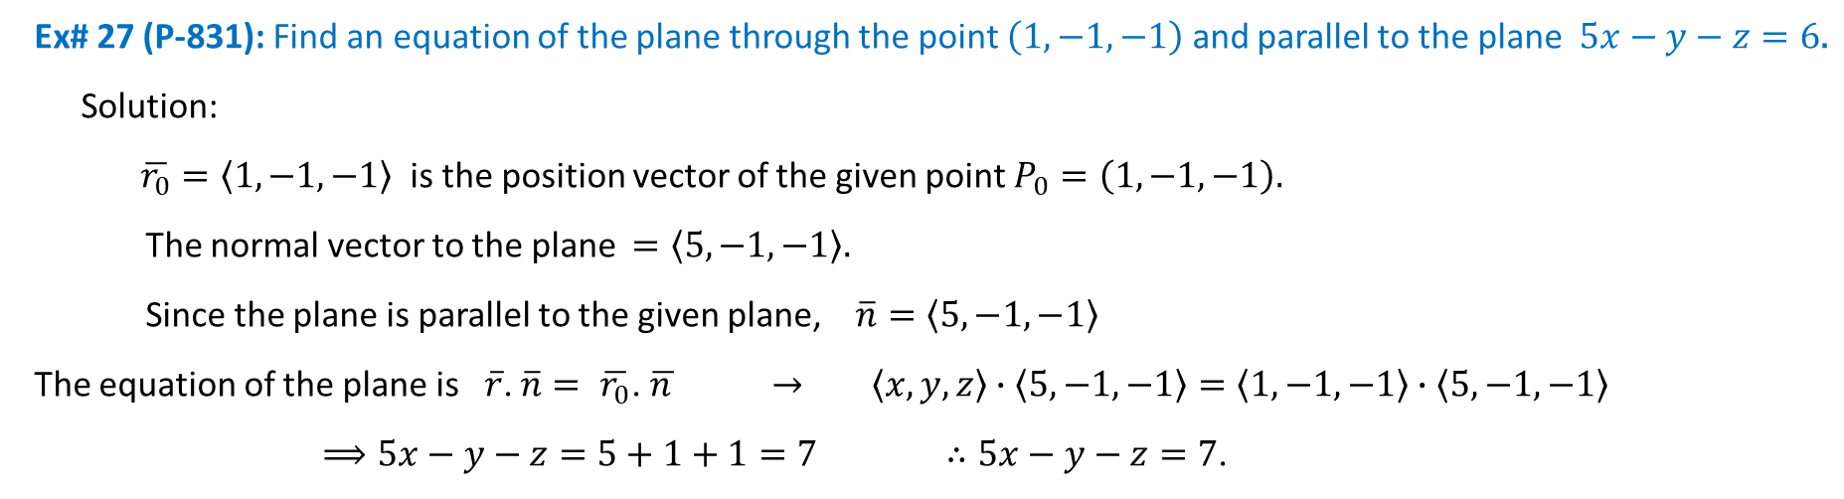
Ex# 27 (P-831): Find an equation of the plane through the point $\left(1, −1, −1\right)$ and parallel to the plane $5x−y−z=6\text{.}$
Solution:
$\overline{r_{0}}=\left\langle 1, −1, −1\right\rangle$ is the position vector of the given point $P_{0}=\left(1, −1, −1\right).$
The normal vector to the plane $=\left\langle 5, −1, −1\right\rangle .$
Since the plane is parallel to the given plane, $\overline{n}=\left\langle 5, −1, −1\right\rangle$
The equation of the plane is $\overline{r}$. $\overline{n}= \overline{r_{0}}\text{. }\overline{n } → \left\langle x,y, z\right\rangle ∙\left\langle 5, −1, −1\right\rangle =\left\langle 1, −1, −1\right\rangle ∙\left\langle 5, −1, −1\right\rangle$
$⟹5x−y−z=5+1+1=7$ $∴5x−y−z=7$.

Slide 18
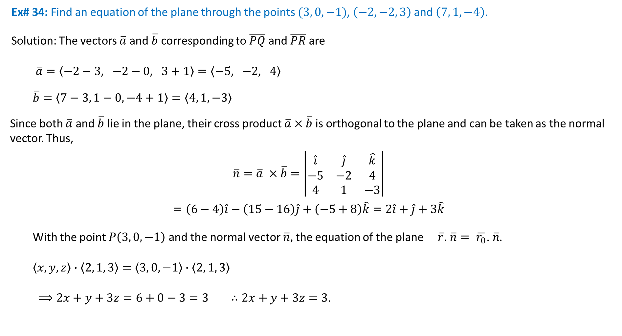
Ex# 34: Find an equation of the plane through the points $(3, 0, −1)$, $\left(−2, −2, 3\right)$ and $\left(7, 1, −4\right)$.
Solution: The vectors $\overline{a}$ and $\overline{b}$ corresponding to $\overline{PQ}$ and $\overline{PR}$ are
$\overline{a}=\left\langle −2−3, −2−0, 3+1\right\rangle =\left\langle −5, −2, 4\right\rangle$
$$\overline{b}=\left\langle 7−3, 1−0, −4+1\right\rangle =\left\langle 4, 1, −3\right\rangle$$
Since both $\overline{a}$ and $\overline{b}$ lie in the plane, their cross product $\overline{a}×\overline{b}$ is orthogonal to the plane and can be taken as the normal vector. Thus,
$$\overline{n}=\overline{a} ×\overline{b}=\left|\begin{matrix}\hat{i} & \hat{j} & \hat{k} \\ −5 & −2 & 4 \\ 4 & 1 & −3\end{matrix}\right|$$
$$=\left(6−4\right)\hat{i}−\left(15−16\right)\hat{j}+\left(−5+8\right)\hat{k}=2\hat{i}+\hat{j}+3\hat{k}$$
With the point $P\left(3, 0, −1\right)$ and the normal vector $\overline{n},$ the equation of the plane $\overline{r}$. $\overline{n}= \overline{r_{0}}\text{. }\overline{n}$.
$\left\langle x,y, z\right\rangle ∙\left\langle 2, 1, 3\right\rangle =\left\langle 3, 0, −1\right\rangle ∙\left\langle 2, 1, 3\right\rangle$
$⟹2x+y+3z=6+0−3=3$ $∴2x+y+3z=3$.
R(7,1,-4)
P(3,0,-1)
Q(-2,-2,3)

Slide 19

Ex# 53 (P-832): Determine whether the planes are parallel, perpendicular, or neither. If neither, find the angle between them. $x+2y−z=2$ and $2x−2y+z=1$.
Solution: The normal vectors of these planes are ${\overline{n}}_{1}=\left\langle 1, 2, −1\right\rangle$ and ${\overline{n}}_{2}=\left\langle 2, −2, 1\right\rangle$.
$$\frac{1}{2}≠\frac{2}{−2}=\frac{−1}{1}$$
Since the D.R’s are not proportional, so they are not parallel.
Now, ${\overline{n}}_{1}∙{\overline{n}}_{2}=2−4−1=−3$
Since $\overline{n_{1}}∙\overline{n_{2}}≠0,$ the two planes are not orthogonal.
If $θ$ is the angle between the planes,
$$\cos{θ}=\frac{\overline{n_{1}}.\overline{n_{2}}}{\left|\overline{n_{1}}\right|\left|\overline{n_{2}}\right|}$$
$$=\frac{\left\langle 1, 2, −1\right\rangle ∙\left\langle 2, −2, 1\right\rangle }{\sqrt{1+4+1}\sqrt{4+4+1}}$$
$$=\frac{2−4−1}{3\sqrt{6}}$$
$$=\frac{−3}{3\sqrt{6}}=\frac{−1}{\sqrt{6}}$$
$$∴θ=\cos^{−1}\left(\frac{−1}{\sqrt{6}}\right)={114}^{0}$$

Slide 20
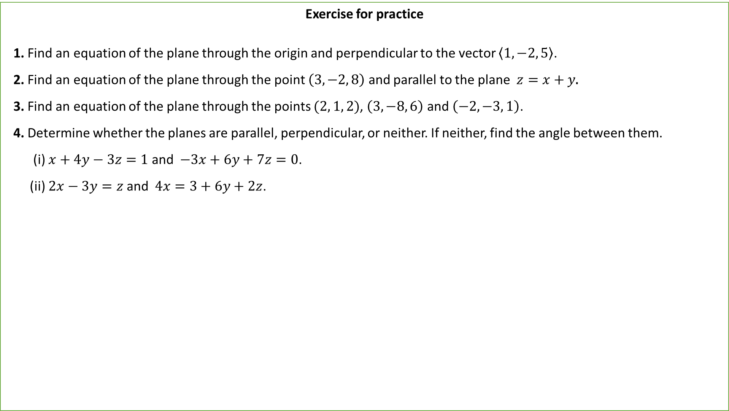
Exercise for practice
1. Find an equation of the plane through the origin and perpendicular to the vector $\left\langle 1, −2, 5\right\rangle$.
2. Find an equation of the plane through the point $\left(3, −2, 8\right)$ and parallel to the plane $z=x+y\text{.}$
3. Find an equation of the plane through the points $(2, 1, 2)$, $\left(3, −8, 6\right)$ and $\left(−2, −3, 1\right)$.
4. Determine whether the planes are parallel, perpendicular, or neither. If neither, find the angle between them.
(i) $x+4y−3z=1$ and $−3x+6y+7z=0$.
(ii) $2x−3y=z$ and $4x=3+6y+2z$.

Slide 21
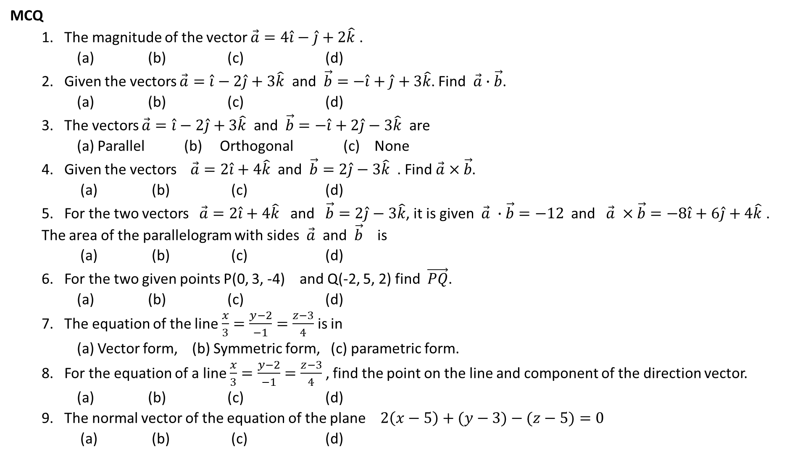
MCQ
1. The magnitude of the vector $\vec{a}=4\hat{i}−\hat{j}+2\hat{k}$ .
(a) (b) (c) (d)
2. Given the vectors $\vec{a}=\hat{i}−2\hat{j}+3\hat{k}$ and $\vec{b}=−\hat{i}+\hat{j}+3\hat{k}$. Find $\vec{a}∙\vec{b}$.
(a) (b) (c) (d)
3. The vectors $\vec{a}=\hat{i}−2\hat{j}+3\hat{k}$ and $\vec{b}=−\hat{i}+2\hat{j}−3\hat{k}$ are
(a) Parallel (b) Orthogonal (c) None
4. Given the vectors $\vec{a}=2\hat{i}+4\hat{k}$ and $\vec{b}=2\hat{j}−3\hat{k}$ . Find $\vec{a}×\vec{b}$.
(a) (b) (c) (d)
5. For the two vectors $\vec{a}=2\hat{i}+4\hat{k}$ and $\vec{b}=2\hat{j}−3\hat{k}$, it is given $\vec{a} ∙\vec{b}=−12$ and $\vec{a} ×\vec{b}=−8\hat{i}+6\hat{j}+4\hat{k}$ . The area of the parallelogram with sides $\vec{a}$ and $\vec{b}$ is
(a) (b) (c) (d)
6. For the two given points P(0, 3, -4) and Q(-2, 5, 2) find $\vec{PQ}$.
(a) (b) (c) (d)
7. The equation of the line $\frac{x}{3}=\frac{y−2}{−1}=\frac{z−3}{4}$ is in
(a) Vector form, (b) Symmetric form, (c) parametric form.
8. For the equation of a line $\frac{x}{3}=\frac{y−2}{−1}=\frac{z−3}{4}$ , find the point on the line and component of the direction vector.
(a) (b) (c) (d)
9. The normal vector of the equation of the plane $2\left(x−5\right)+(y−3)−(z−5)=0$
(a) (b) (c) (d)

